Slide 1
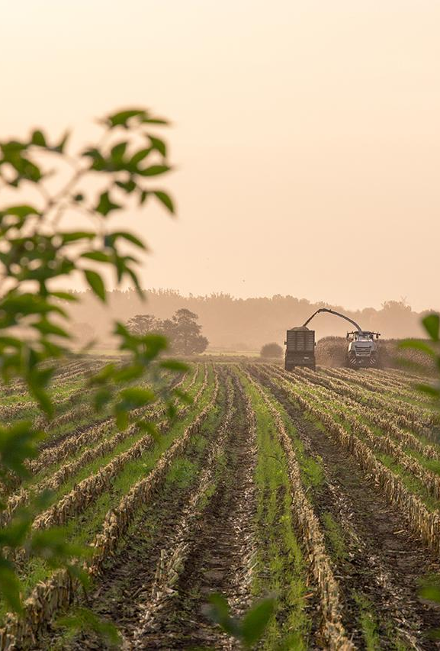
RenewAgra Customer Journey Roadmap Exemplar
THE FUTURE OF CROPS

Slide 2
Overview
RenewAgra – multi-national farming conglomerate consisting of three agricultural service businesses:
CropCo – farm services including planting, harvesting, food processing
TransCrop – superior transportation services through high-tech supply chain management
EnvoData – research and data services to farmers using advanced monitoring technology

Slide 3
Business and Technical Requirements
Update CropCo’s accounting software
Improve CropCo’s HR software to manage seasonal employees
Leverage EnvoData’s environmental data to benefit CropCo and TransCrop, particularly regarding rain prediction and irrigation needs
Expand TransCrop’s GPS tracking services to Brazil and India
Update EnvoData’s ERP
General visibility of and interconnectedness of the three businesses

Slide 4
Business and Technical Requirements, cont.
In India, Brazil, the US, and Mexico regulatory requirements will differ.
Country specific requirements include:
Tax regulations and other reporting obligations for finance
Different environmental regulations
Different human resource regulations
Data protection laws

Slide 5
Business and Technical Requirements, cont.
What data needs are you currently meeting with Excel?
What other software is being used and for what purpose?
How would you like to see GPS tracking services expanded?
What are your regulatory and compliance needs in terms of taxes, the environment, and information security?
How is the company affected by environmental factors?

Slide 6
Business and Technical Requirements, cont.
Will you be expanding to any new countries and need to comply with other regulations?
Will outsourcing or “crowd-sourcing” of transportation be used in the future to keep up with transportation demand?
What visibility of the three businesses does RenewAgra need?

Slide 7
Stakeholders and Partners
Stakeholder | Influence | Interest | Level of Participation
Leadership Representatives | High | High | Low
CropCo Processing Plant Engineers | High | High | High
TransCrop Account Managers | High | High | Low
IT Representatives | Low | High | High

Slide 8
Stakeholders and Partners, cont.
Stakeholder | Influence | Interest | Level of Participation
EnvoData Analyst | Low | Low | High
EnvoData Technology Partner | High | High | High
SAP Project Manager | Low | High | High
SAP Technology Consultant | Low | High | High

Slide 9

Stakeholders and Partners, cont.
SAP Partner: Geotab
Geotab offers fleet management solutions designed for service fleets and heavy trucks as well as around productivity, sustainability, fleet optimization, compliance, safety and more.
As an IoT hub, the in-vehicle device captures vehicle, GPS, and driver behavior data.

Slide 10
Business Environment
SWOT Analysis
The SWOT analysis allows you to analyze Strengths, Weaknesses, Opportunities, and Threats. SWOT is excellent for assessing "as-is" and determining desired "to-be."
PESTLE Analysis
PESTLE allows you to analyze a company's operating environment. PESTLE factors include Political, Economic, Social, Technology, Legal, and Environmental.

Slide 11
Business Environment
CropCo PESTLE Analysis
Political – international trade bans and agreements
Economic – price fluctuations
Social – public concern about GMOs
Technology – data protection laws differ from country to country
Legal – hiring laws, regulations pertaining to transportation
Environmental – contamination from runoff, depletion of water supply, climate change

Slide 12
Business Environment, cont.
TransCrop PESTLE Analysis
Political – political instability, subsidies and tariffs, government policies
Economic – labor costs, consumer demand, price fluctuations, availability of materials
Social – unique cultures (holidays, leave, and management styles), demographics and skill level of population
Technology – technological expertise of workforce, infrastructure, scientific knowledge
Legal – trade agreements, anti-trust laws, property rights, pollution regulations, employment laws
Environmental – weather, floods, road conditions,

Slide 13
Business Environment, cont.
EnvoData PESTLE Analysis
Political – data ownership, misuse of data, data privacy, EU-US Privacy Shield agreement
Economic – technology costs, end-user adoption, monetization of data
Social – human capital, social capital, career attitudes
Technology – data storage, technological infrastructure and maturity, R&D innovation
Legal – licensing, patents, intellectual property law
Environmental – attitudes towards advanced technologies (drones), energy consumption,

Slide 14
Products and Solutions
Pain Point | Company or Business | Solution | Notes
Lack of visibility across company | RenewAgra | SAP Integration Suite | Integrate CropCo and TransCrop with EnvoData’s existing solutions.
No single source of truth | RenewAgra | SAP Cloud Platform | Solves fragmented financial reporting processes.
Reporting and engineer record keeping using Excel and paper | CropCo | SAP Cloud Platform | Standardize Data Retention
Limited GPS tracking | TransCrop | Expand GPS to Brazil and India | Visibility of truck movement for RenewAgra
No land analysis product | EnvoData | LoRaWAN Sensor | Use drones to view and sample entire farms.

Slide 15
SAP Team Training Strategies
Train the team on the SAP products to be implemented
Train team on customer’s existing platforms
Train team to use the SAP Solution Manager for project collaboration, communication, tracking and reporting
Team building exercises

Slide 16

Conclusion
Summary of discovery and explore phases
Preview of analysis and design phases
Value-added benefits of SAP solutions
Increased crop yields
Mitigation of unfavorable weather conditions
Visibility of company data for decision making and planning
Partner involvement
Future plans
Next steps

